Slide 1
Football Data Analysis Project

Slide 2
Objective:
To analyze:
The impact of offensive contributions.
Player attributes
Team Comparison
Investigate stadium attendance
Strategic recommendations

Slide 3
Tools and Technologies
IDE
Language
Database
MS Excel
Tableau
Python
MySQL

Slide 4
PROCESS DIAGRAM
Data conversion
MySQL
connect
Python
Data Merging
Preprocessing & Cleaning
Analysis
Visualization
Tableau

Slide 5
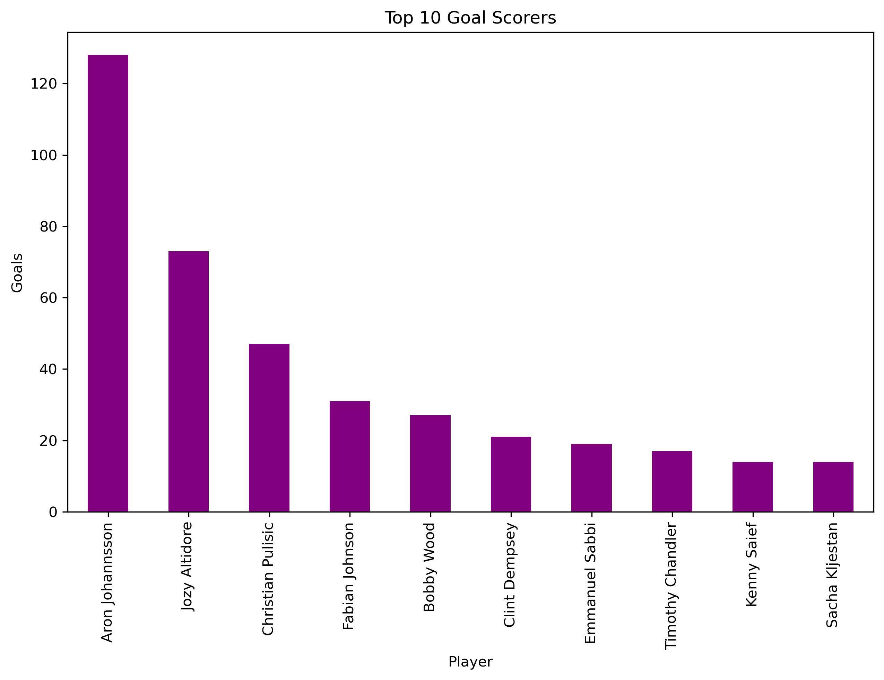
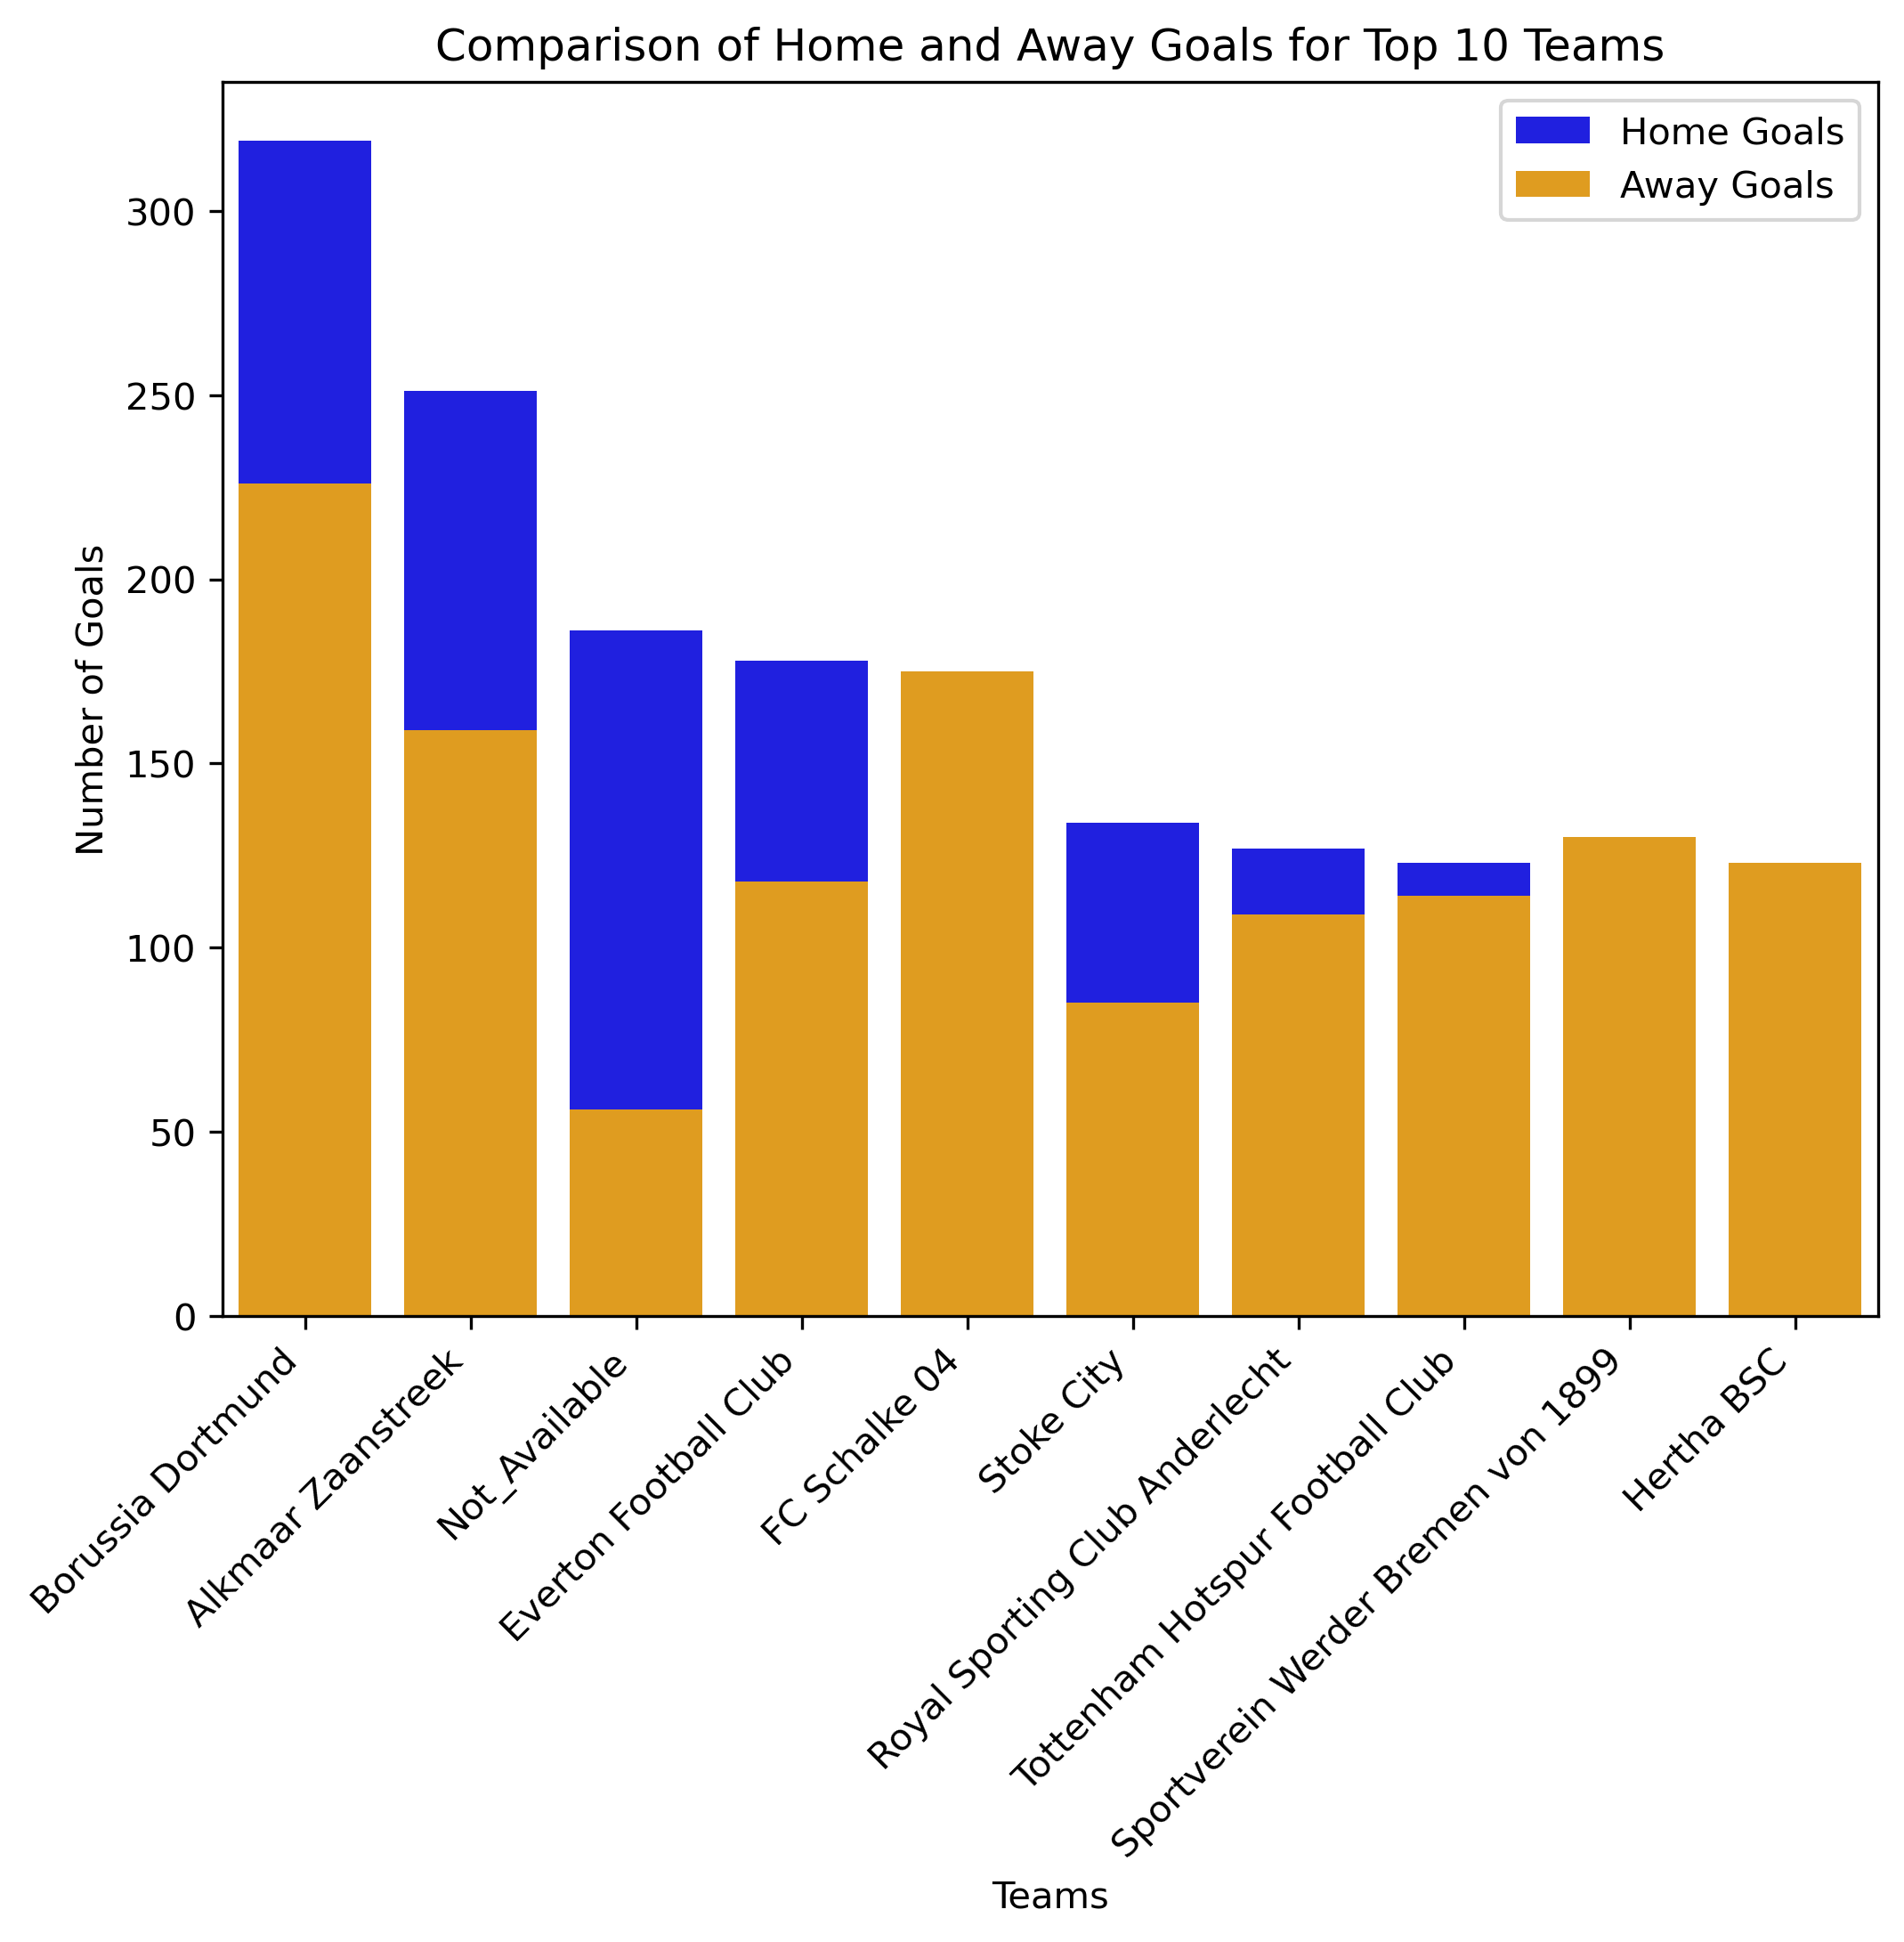
Focus Areas:
Performance Analysis:
Aron Johannson with the highest goals (128), followed by Jozy Altidore (73) and Christian Pulisic (47).
Christian Pulisic has highest Assists (33), followed by Fabian Johnson (29) and Aron Johannson (20).
Borussia Dortmund has the highest goals, more in the home matches.
AFC Ajax Amsterdam has the best average position of 4.5.

Slide 6
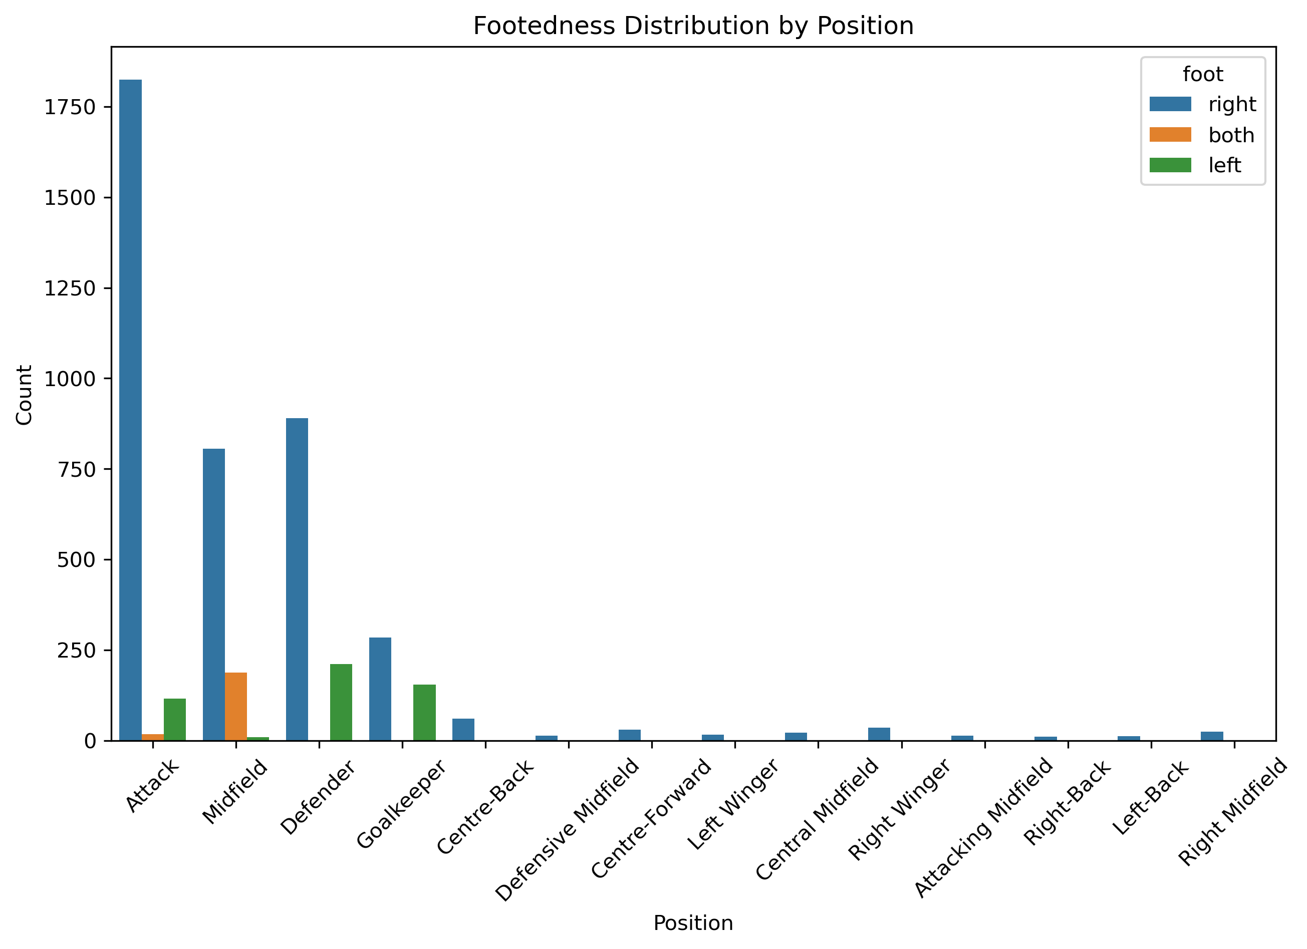
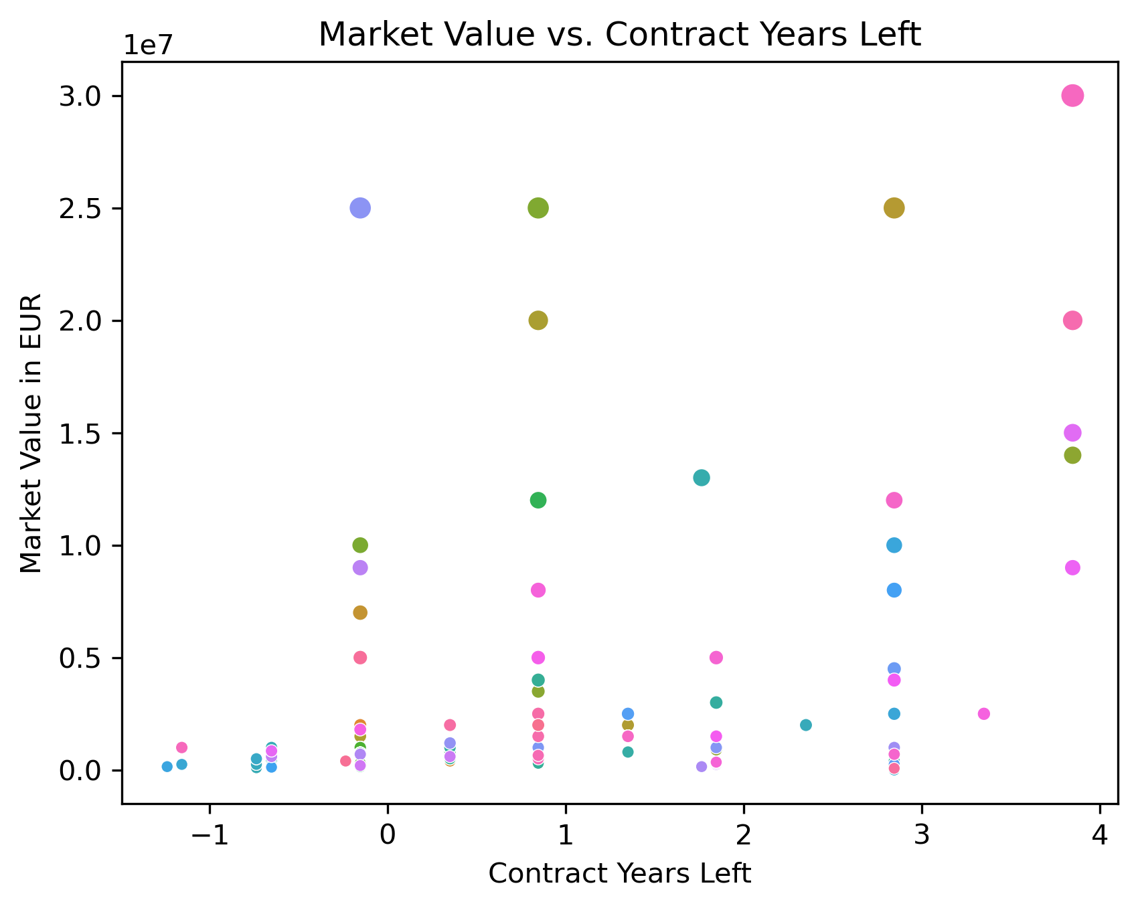
Player Profile and Market Value:
Majority of the Players are right-footed especially in the attack position.
Age groups:
Age group 35-40 = 41.1%
Age group 30-35 = 27.4%
Age group under 30 = 23.5%
Age group above 40 = 8.0%
c) More contract years left, more the market value

Slide 7
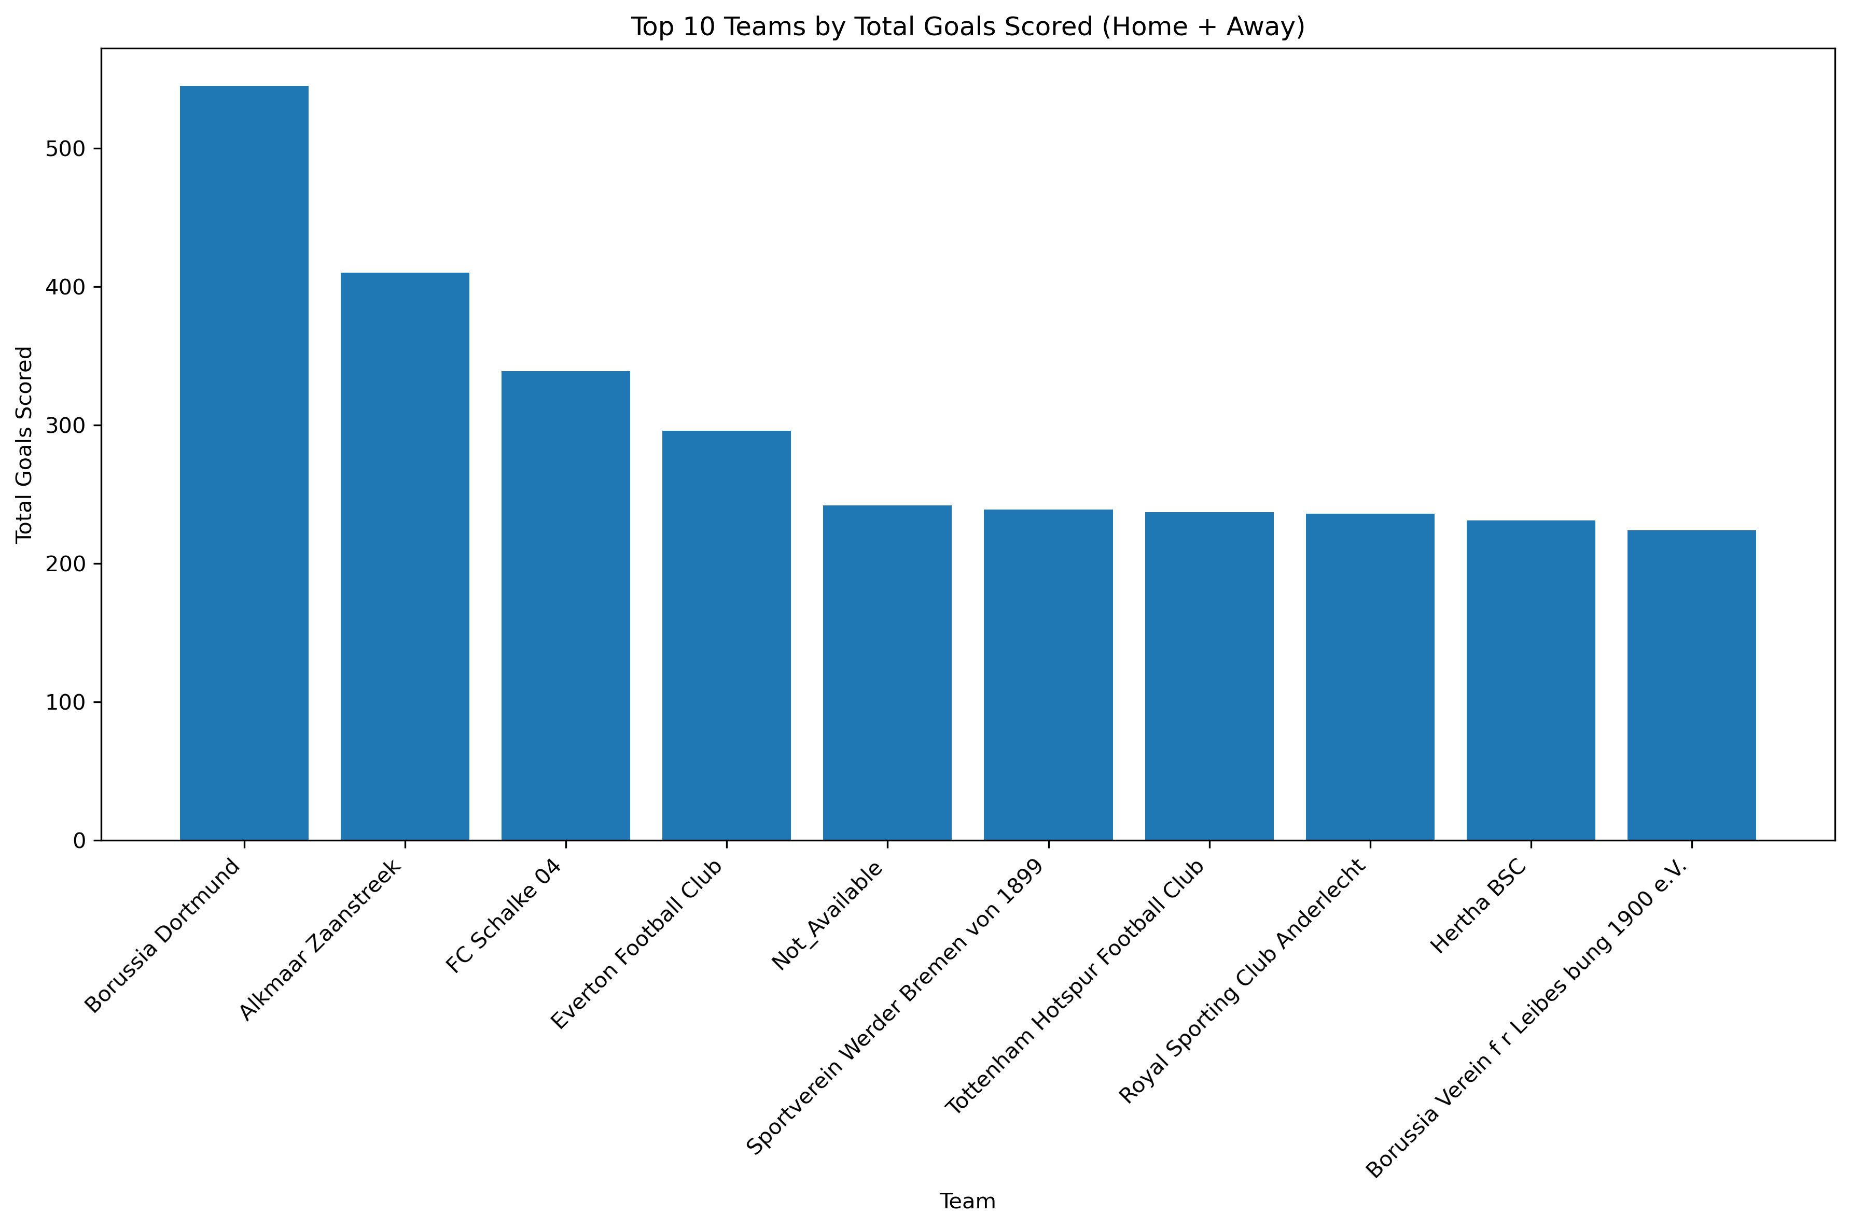
Team Comparison:
Borussia Dortmund has the highest total goals scored, followed by Alkmaar Zaanstreek and FC Schalke.
Alkmaar Zaanstreek stands out with the players in attack position with the highest goals scoring.

Slide 8
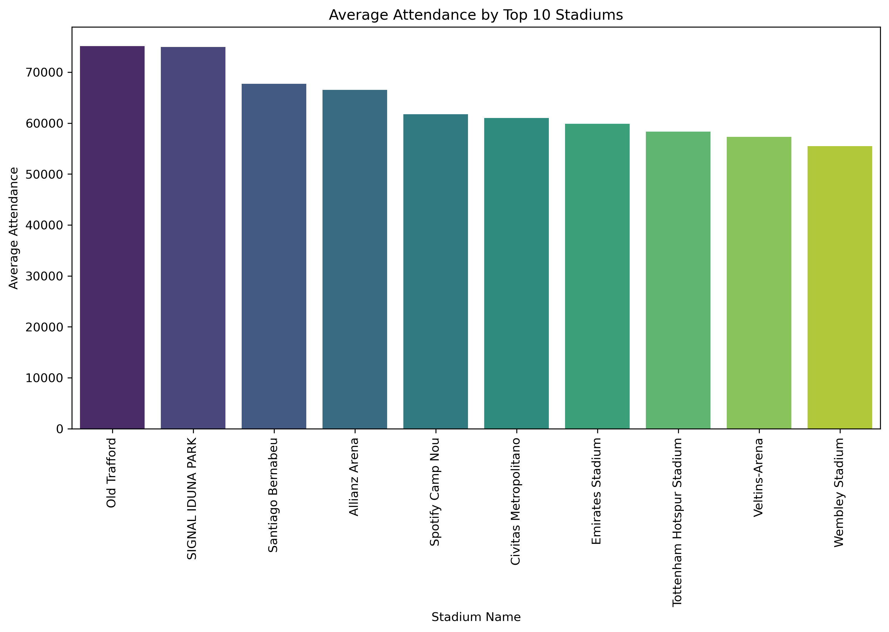
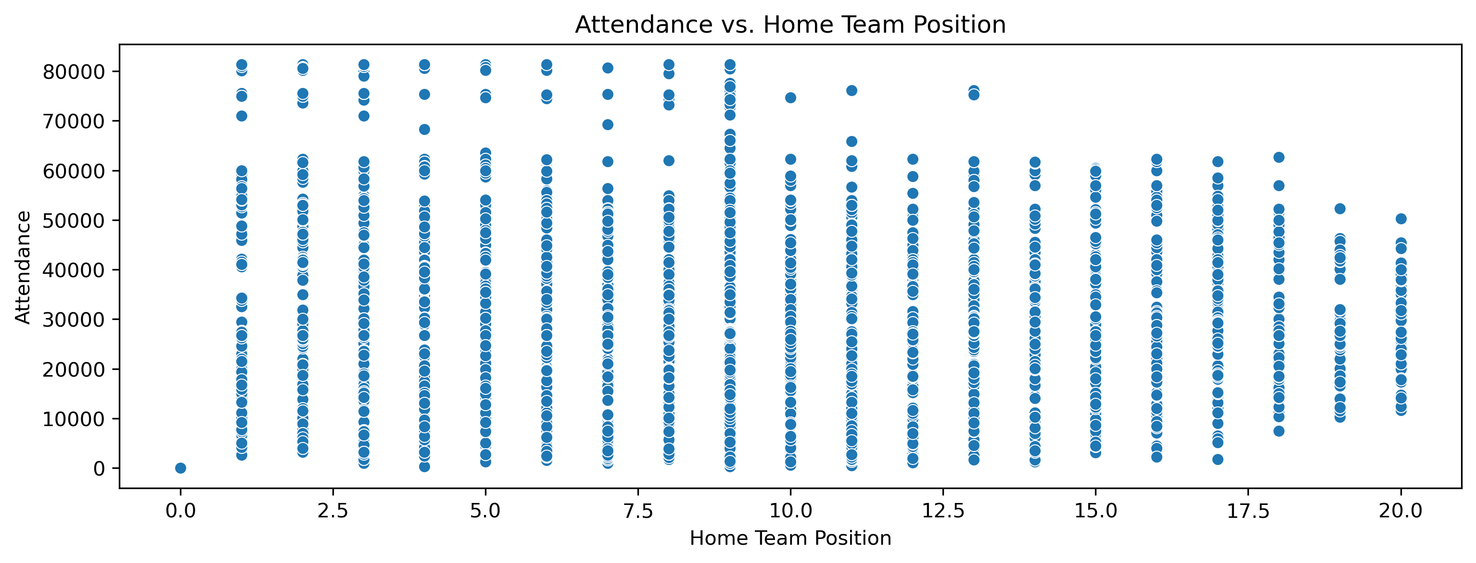
Attendance and Stadium Analysis:
Highest Attendance recorded in the Old Trafford Stadium, followed by Signa Iduna Park with a slight difference.
Better team position attracts larger crowds.

Slide 9
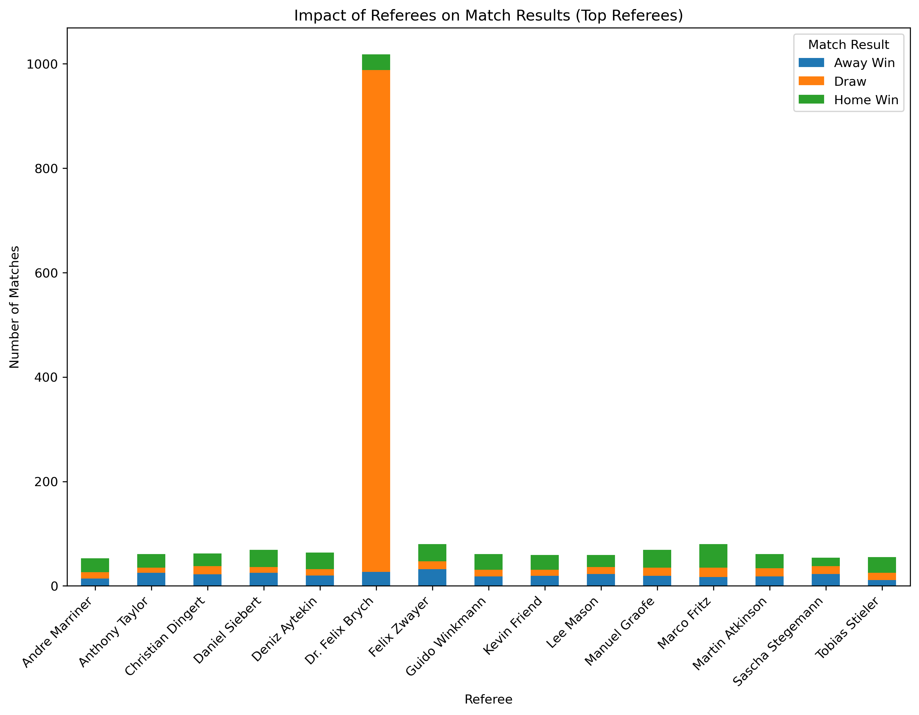
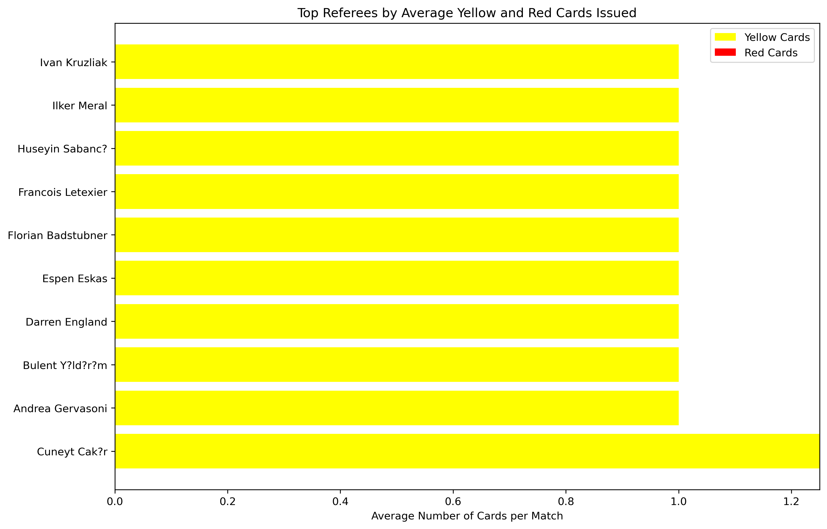
Referee Analysis:
Dr. Felix Brych officiated most matches which ended in draw.
Cuneyt Cakr issued the highest number of cards mostly yellow cards.

Slide 10
Substitution Patterns:
Majority of the substitutions were made in the first half with centre-back position the most.
Most of the substitution players has the average age of 37.
Domestic-league type of competition stands out with the highest number of substitution players than domestic-cup and international cup.

Slide 11
Event Analysis:
Substitution event type occurred the most.
Jermaine Jones appeared the most in the cards events.
Aron Johannson appeared the most in Goals events.
Fabien Johnson appeared the most in Substitution events.
Competition Analysis:
Highest number of records: Domestic-league
Highest number of Home and Away goals: Domestic-league
Match Outcome:
Draw = 39.02%
Home Win = 36.11%
Away Win = 24.87%

Slide 12
Player Attributes and Demographics:
77.90% of the players belong to United States.
Age Group of above 30 has the highest goals scored in the attack position.
Majority Players are right-footed. Most of them playing in the attack position.
Contract Management:
The more the contract years left, the more their market value.
Players in the Attack position has the highest average market value.

Slide 13
Conclusion
Strategies that will boost teams success.
Stadiums like Old Trafford and Signal Iduna Park attracts larger crowds.
Players like Aron Johannson and Christian Pulisic are key players for teams’ success.
Extending the contracts for such key players.

Slide 14
Thank You

